Slide 1
Building Wind Farms Next to Series Capacitor Banks: Lessons Learned
Ahmad Abdullah, Billy Yancey and Mahdi Kefayati

Slide 2
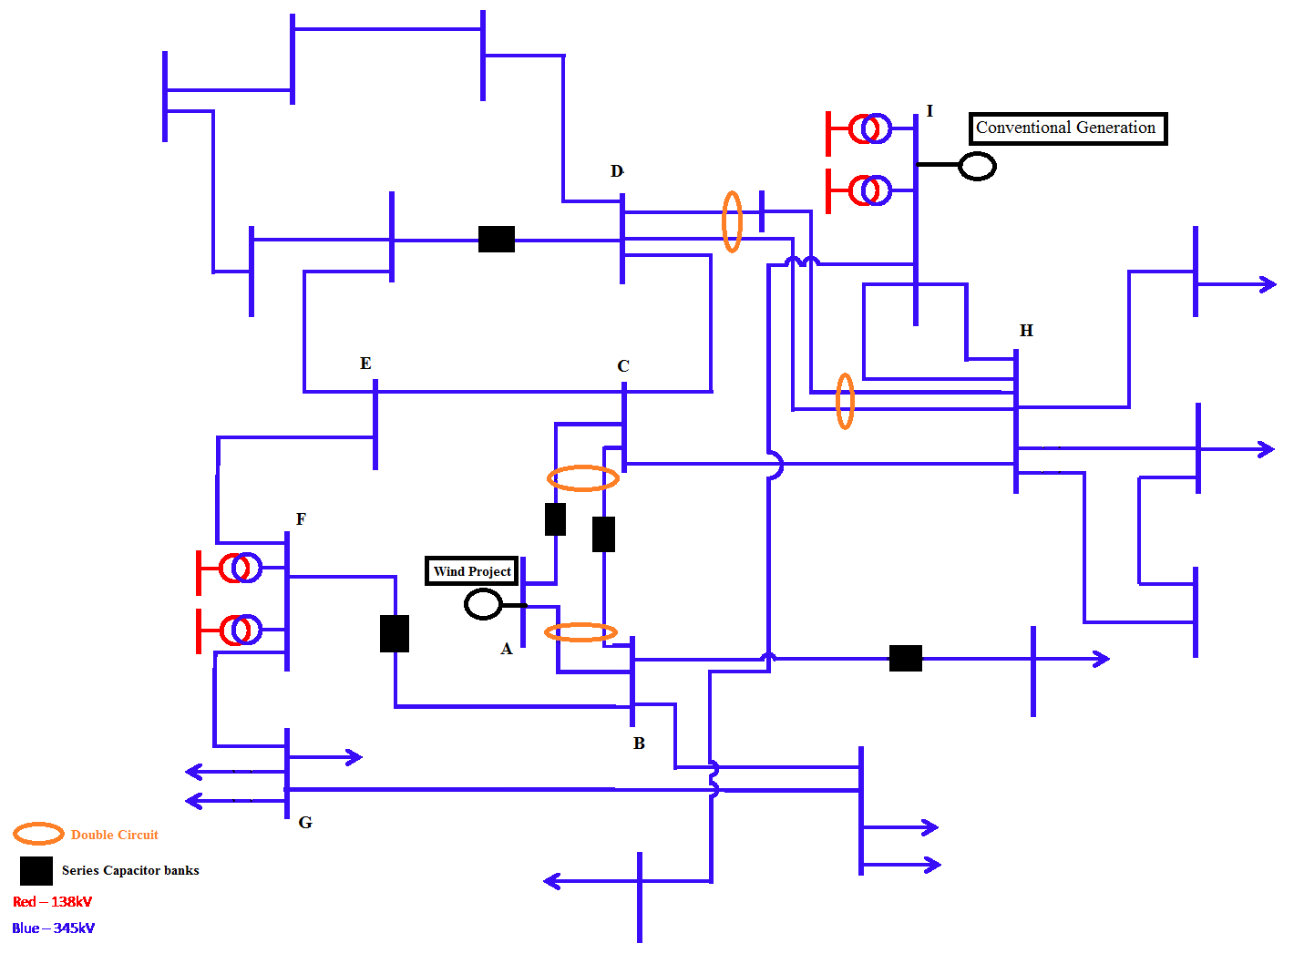
Overview
A subsynchrnous oscillations study for a wind project in ERCOT
The project is located next to large series capacitor bank that compensates 100% of line length
A fault nearby would cause the project to go offline
Investigations showed that the trip is not due to SSO but due to the proximity to series capacitor banks

Slide 3
Contents
A frequency scan analysis
A detailed electromagnetic transient (EMT) study
Investigations of the wind farm trip

Slide 4
Introduction
SSO has become a concern to ISOs and TSOs since the two incidents of shaft damage experienced at the Mohave generating station
The subject has received renewed attention due to the incident that occurred in Texas in 2009 which revealed that inverter based generation can be also be affected by SSO
ERCOT requires an SSO study before project energization

Slide 5
Frequency Scan Analysis
Done for screening purposes
The purpose of the scan is to reduce the number of cases needed for detailed EMT analysis
A grid side scan and a project side scan under different operating conditions are done
Both the grid side and the project side scans are combined to assess the amount of damping resistance available when the reactance crosses zero

Slide 6
Grid side scan
Performed to determine the contingencies, if any, up to N-5 that result in the WP to become near radial or radially connected to the series compensated transmission lines
Used to calculate the equivalent resistance and reactance looking into the transmission network at the project’s POI for different contingency conditions, up to N-5, that may show vulnerability to SSO due to becoming radially connected to series compensation capacitors
Additionally, for each of these contingencies, various combinations of sensitivities were evaluated. These sensitivities are:
the switched shunts are switched ON or OFF
the series capacitor banks are ON or OFF
Various generation levels and wind output in the Panhandle area

Slide 7
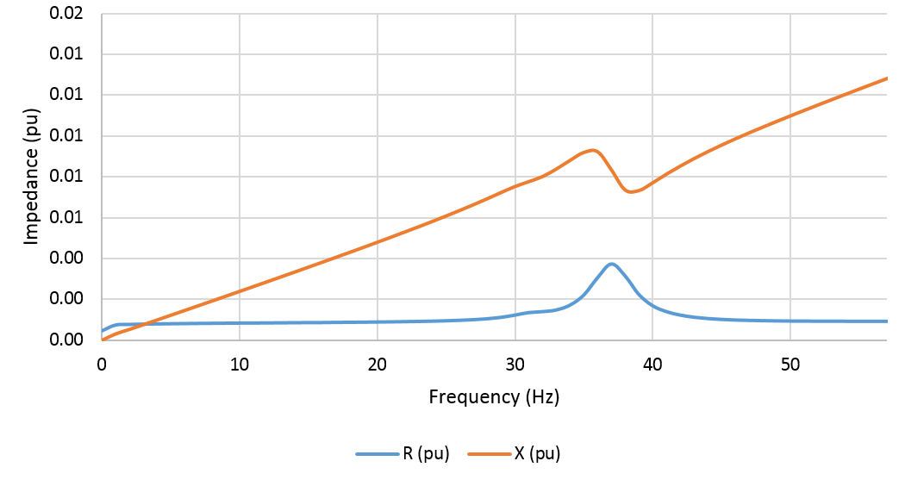
Grid side scan
A total of 350 scans have been performed
Frequency scan with no contingency
Frequency scan under different contingency conditions

Slide 8
Project side frequency scan
This frequency scan looked into the WP from the POI and included the wind turbines, the most recent collection system design and layout as well as the current main power transformer and pad mount transformers
The results from the project frequency scan shows that the reactance of the project is positive for all frequencies under study
Various sensitivities were evaluated. These sensitivities are:
The series compensation option turned ON or OFF
The wind generation of the project

Slide 9
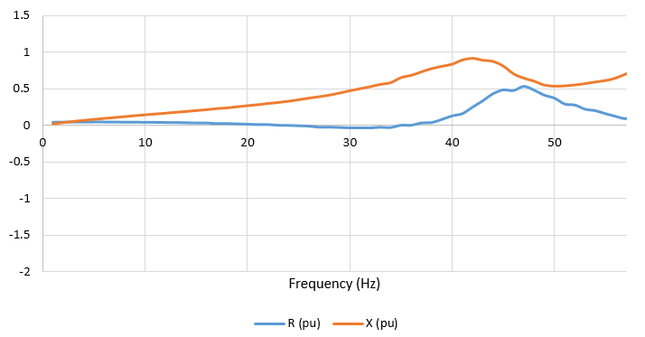
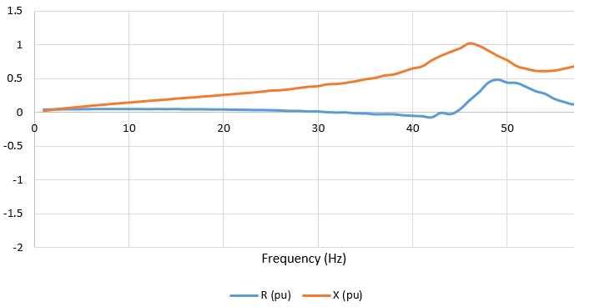
Project side frequency scan
10% output with series compensation OFF
10% output with series compensation ON

Slide 10
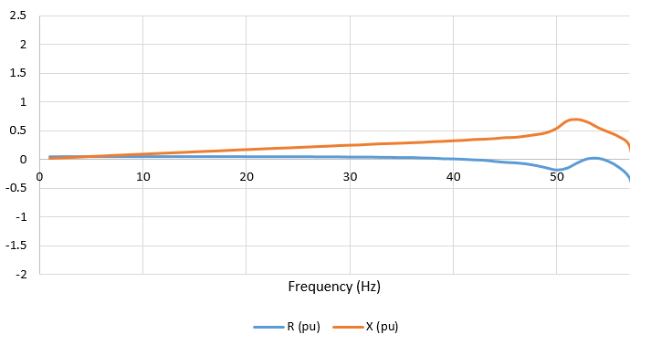
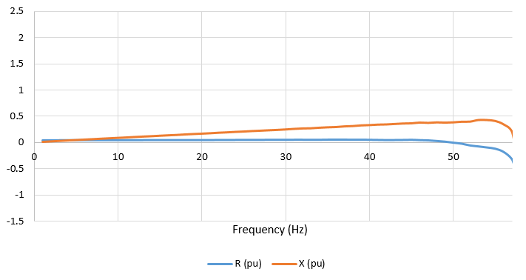
Project side frequency scan
100% output with series compensation OFF
100% output with series compensation ON

Slide 11
Combined Frequency Scan
10% output
100% output

Slide 12
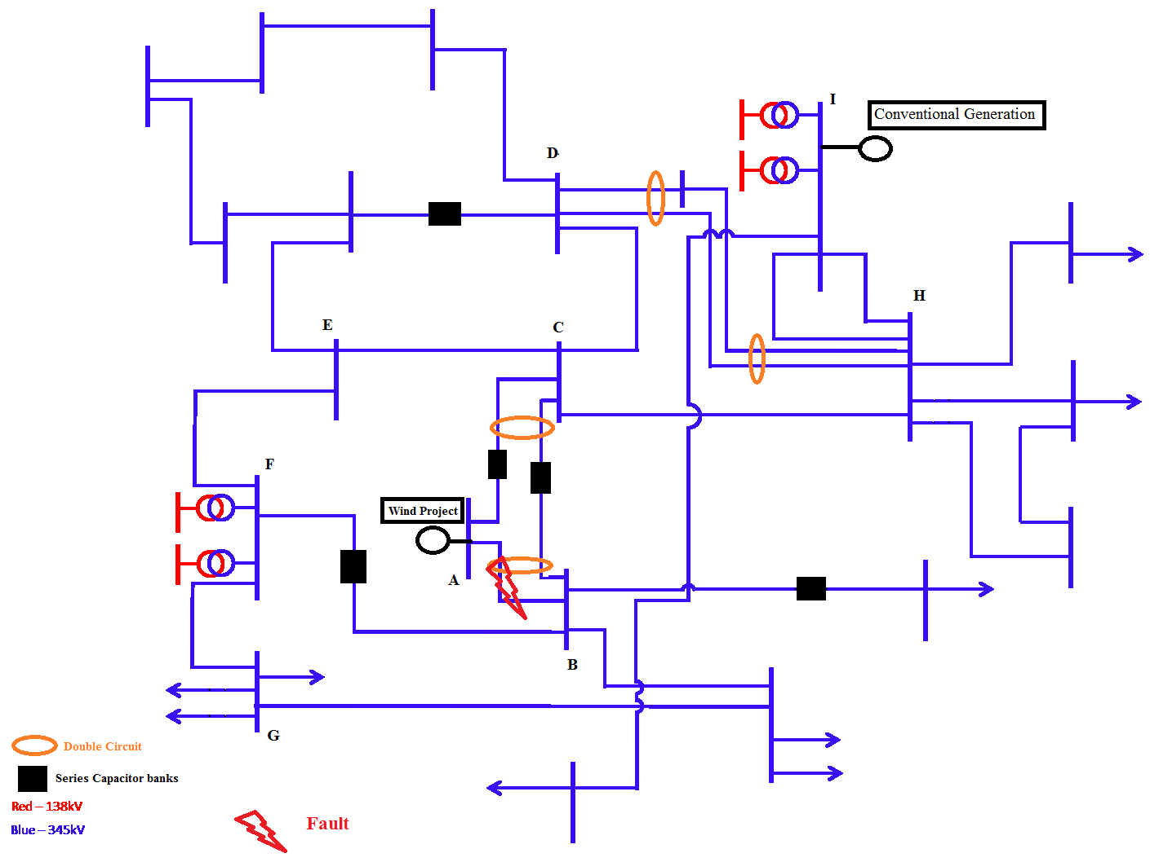
Detailed EMT analysis
Three phase fault on transmission line A-B
Fault is cleared within 5 cycles
Monitored at POI:
Active and reactive power
Voltage and frequency
The objective is to observe whether the project remain stable after fault clearing

Slide 13
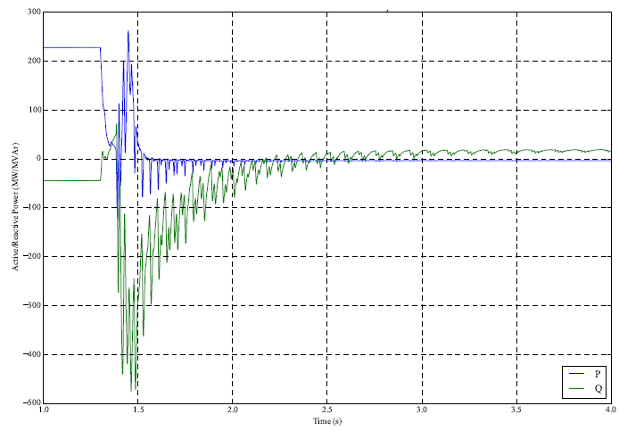
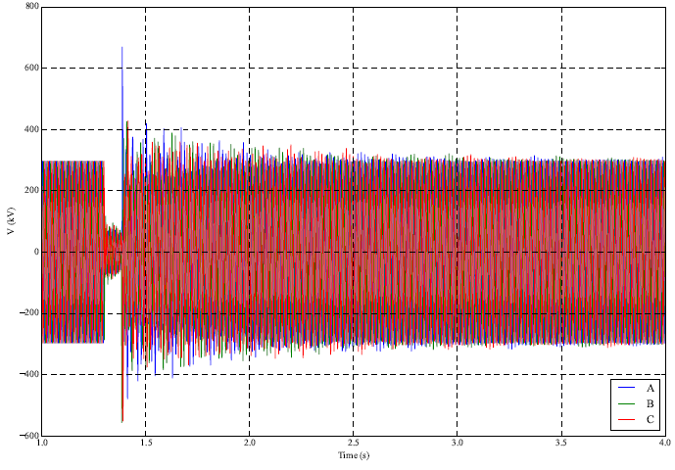
Detailed EMT analysis - Results
Project will trip after fault clearing
Project absorbing enormous reactive power
Reactive Power
POI Voltage

Slide 14
Explanation of trip event
Series Capacitor bank is compensating 100% of line length
The bank stays online during and after clearing the fault (design decision by TSO)
During fault capacitor charges
After fault, the voltage changes abruptly causing enormous reactive power to be release to the project

Slide 15
Recommendations
Trip series capacitor bank during fault (rejected by TSO due to technical reasons)
Obtain a waiver for the project to trip during fault (granted by ERCOT)

Slide 16
Questions?
Thanks you!

